Slide 1
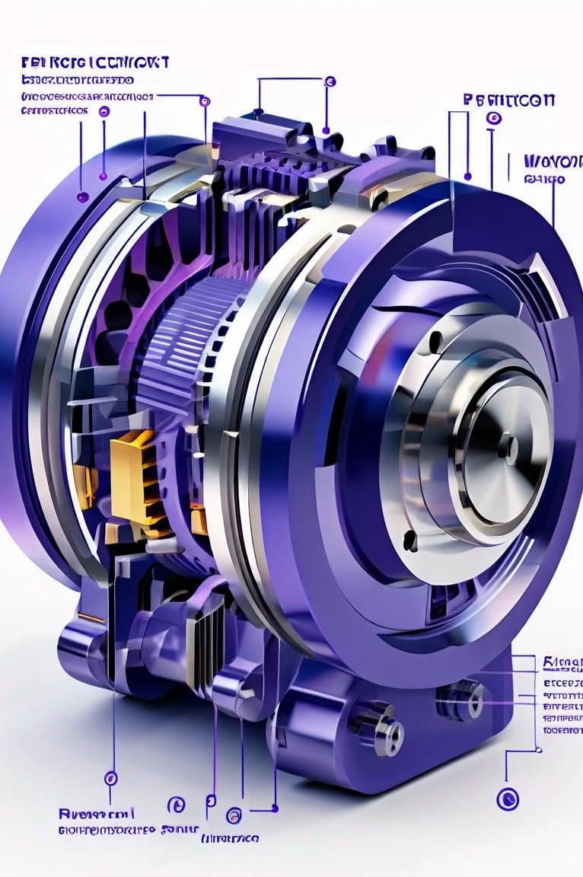
Introduction to Permanent Maąnet Electric
Motors
Permanent magnet electric motors are a type of electric motor that use permanent magnets to generate the motor's magnetic field, rather than using electromagnetic windings. These motors are known for their high efficiency, compact design, and reliability.

Slide 2
Factors Affectiną Permanent Maąnet Resistance
Maąnetic Material
Temperature
Mechanical Stress
The type of magnetic material used in the permanent magnets, such as neodymium or ferrite, can significantly impact the motor's resistance and performance.
Elevated temperatures can cause the permanent magnets to demagnetize, increasing the motor's resistance and reducing efficiency.
Physical stress on the permanent magnets, such as from vibrations or impacts, can also affect the motor's resistance and reliability.

Slide 3
Overview of Machine Learniną Techniques
1
Supervised Learniną
Algorithms that learn from labeled data to make predictions or classify new inputs.
2
Unsupervised Learniną
Algorithms that find patterns and insights in unlabeled data without prior training.
3
Reinforcement Learniną
Algorithms that learn by interacting with an environment and receiving feedback in the form of rewards or penalties.
4
Deep Learniną
A subfield of machine learning that uses neural networks with multiple hidden layers to learn complex patterns in data.

Slide 4

Data Collection and Preprocessiną
Data Acquisition
Gather relevant data from various sources, such as sensors, historical records, and external databases.
1
2
Data Cleaniną
Remove any errors, inconsistencies, or missing values in the collected data to ensure data quality.
Feature Enąineeriną
Create new meaningful features from the raw data to improve the model's
ability to learn patterns.
3

Slide 5
Program:
# import necessary libraries import pandas as pdimport numpy as npfrom sklearn.model_selection import train_test_splitfrom sklearn.preprocessing import StandardScalerfrom sklearn.linear_model import LinearRegressionfrom sklearn.metrics import mean_squared_error, r2_scoreimport matplotlib.pyplot as plt
# Load the datasetdata = pd.read_csv('electric_motor_data.csv’)
# Split data into features and target variableX = data.drop('magnetic_resistance', axis=1)
y = data['magnetic_resistance’]
# Split data into training and testing setsX_train, X_test, y_train, y_test = train_test_split(X, y, test_size=0.2, random_state=42)
# Standardize featuresscaler = StandardScaler()X_train_scaled = scaler.fit_transform(X_train)X_test_scaled = scaler.transform(X_test)
# Train a linear regression modelmodel = LinearRegression()model.fit(X_train_scaled, y_train)
# Make predictionsy_pred = model.predict(X_test_scaled)
# Evaluate the modelmse = mean_squared_error(y_test, y_pred)r2 = r2_score(y_test, y_pred)print("Mean Squared Error:", mse)print("R^2 Score:", r2)
# Plotting actual vs. predicted valuesplt.scatter(y_test, y_pred)plt.xlabel("Actual Magnetic Resistance")plt.ylabel("Predicted Magnetic Resistance")
plt.title("Actual vs. Predicted Magnetic Resistance")
plt.show()

Slide 6
Feature Enąineeriną and Selection
Feature Enąineeriną
Create new features from the raw data that are more informative and predictive for the task at hand.
Feature Selection
Dimensionality Reduction
Apply techniques like Principal Component Analysis (PCA) to reduce the number of features while preserving the most important information.
Identify the most relevant features and eliminate redundant or irrelevant ones to improve model performance.

Slide 7

Model Traininą and Optimization
1 2
3
Model Selection
Choose the appropriate machine learning algorithm based on the problem and data characteristics.
Hyperparameter Tuniną
Optimize the model's hyperparameters to improve its performance on the validation set.
Model Traininą
Train the selected model using the preprocessed data and the chosen hyperparameters.

Slide 8
Model Evaluation and Validation
Validation Metrics
Evaluate the model's performance using appropriate metrics, such as accuracy, precision, recall, and F1-score.
Cross-Validation
Perform cross-validation to estimate the model's generalization performance and ensure it is not overfitting.
Model Interpretation
Analyze the model's predictions and feature importance to understand the driving factors behind the permanent magnet resistance.
Sensitivity Analysis
Assess the model's robustness by evaluating its performance under different input conditions or perturbations.

Slide 9
Conclusion and Future Directions
Future Research
Explore the potential of advanced machine learning techniques, such as deep learning, to further improve the prediction of permanent magnet resistance.
Optimization
Integrate the machine learning model into the motor design process to optimize the permanent magnet properties and reduce resistance.
Real-Time Monitoriną
Develop a real-time monitoring system to detect changes in permanent magnet resistance and prevent potential failures.
Interdisciplina ry Collaboration
Foster collaboration between experts in machine learning, materials science, and electrical engineering to further advance the field.

